Slide 1
Visualizing Data

Slide 2

Column Charts & Bar Charts
Columns = vertical
Bars = horizontal
Height / Length = magnitude

Slide 3
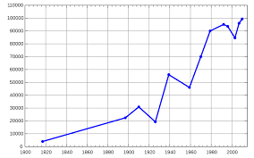
Line Chart
Used for time-series data
Connect data points at each point in time with a line
Multiple lines can be plotted on same chart

Slide 4
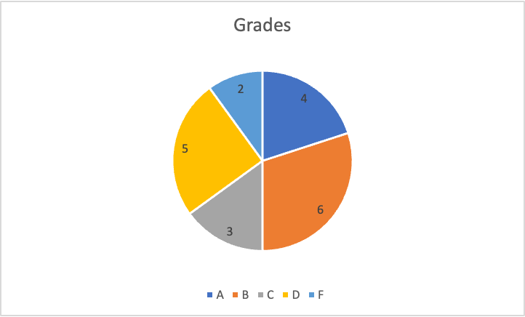
Pie Chart
Used to illustrate the percentage of the total that each category (slice) makes up
Larger slices = larger percent of total data
Data must be categorical

Slide 5
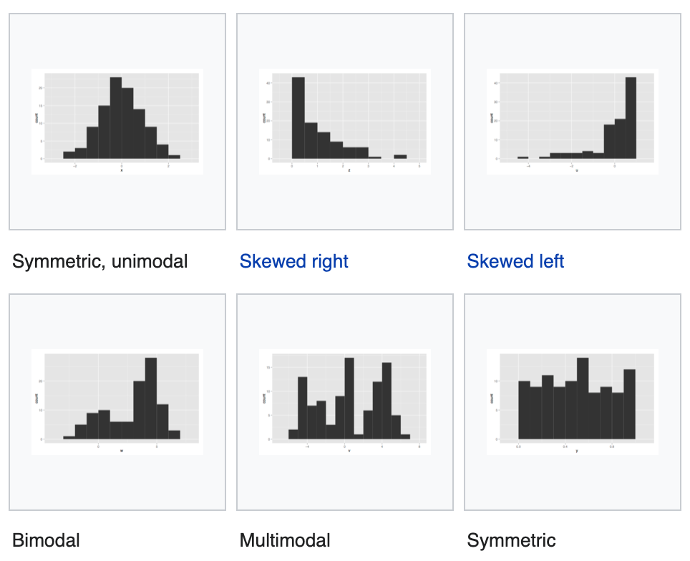
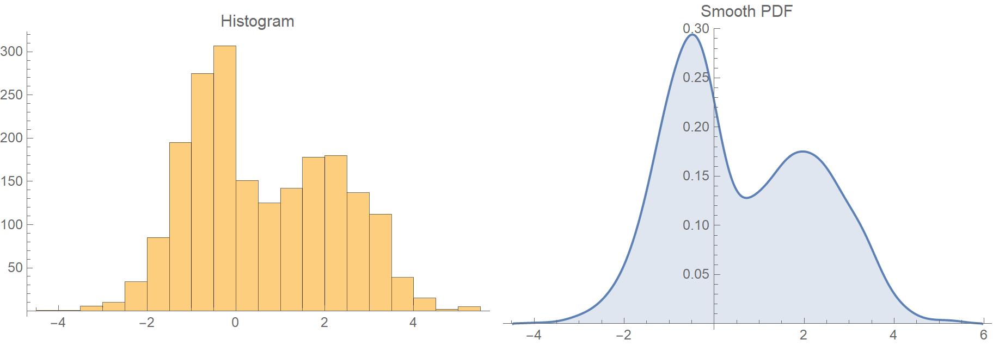
Histograms
Used to show the distribution of continuous quantitative data
Becomes a kernel-density plot when smoothed out

Slide 6
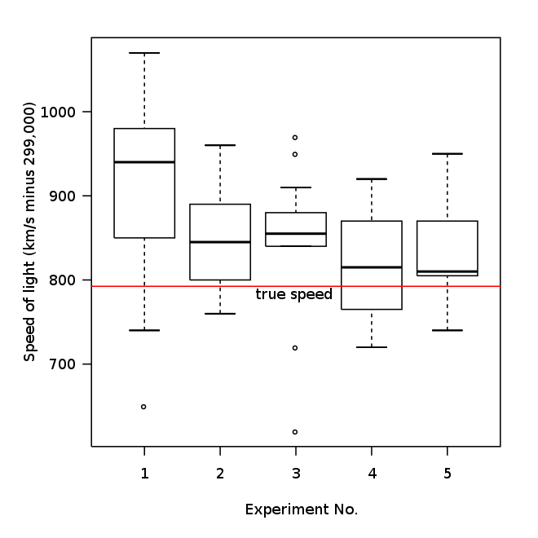
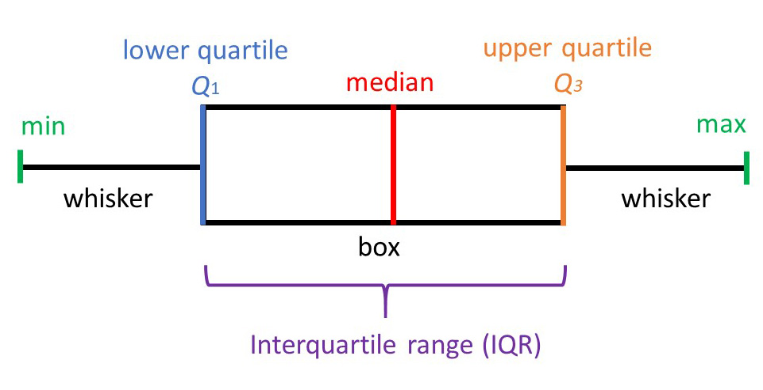
Box(and Whisker) Plot

Slide 7
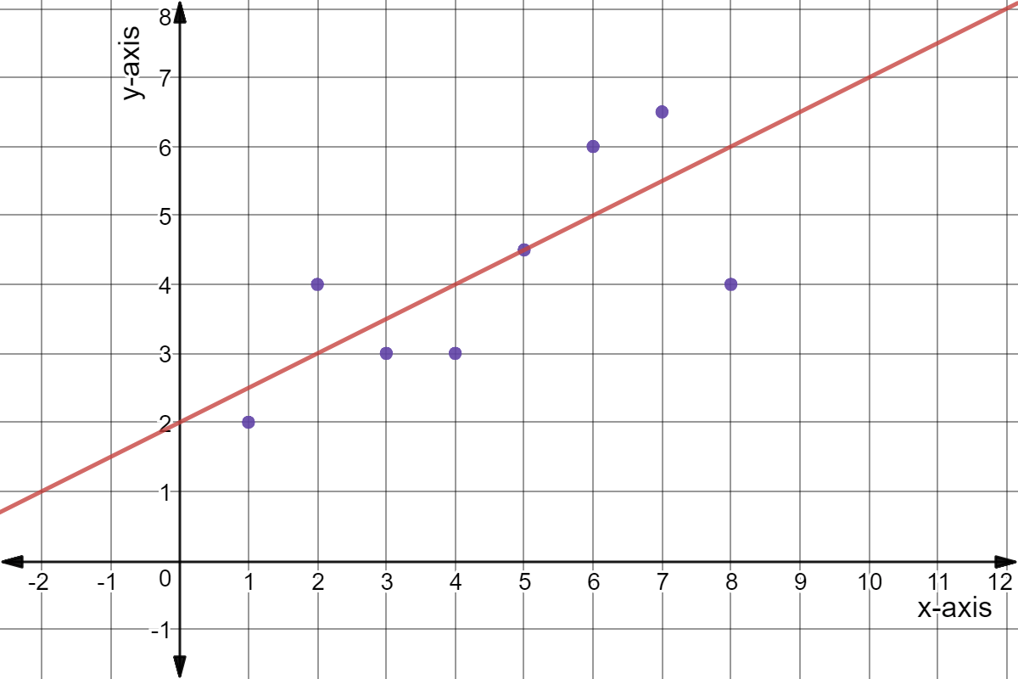
Scatter Plot
Plot X’s and Y’s on a coordinate plane
Dots represent each ordered pair
Often a trend line is plotted as well

Slide 8
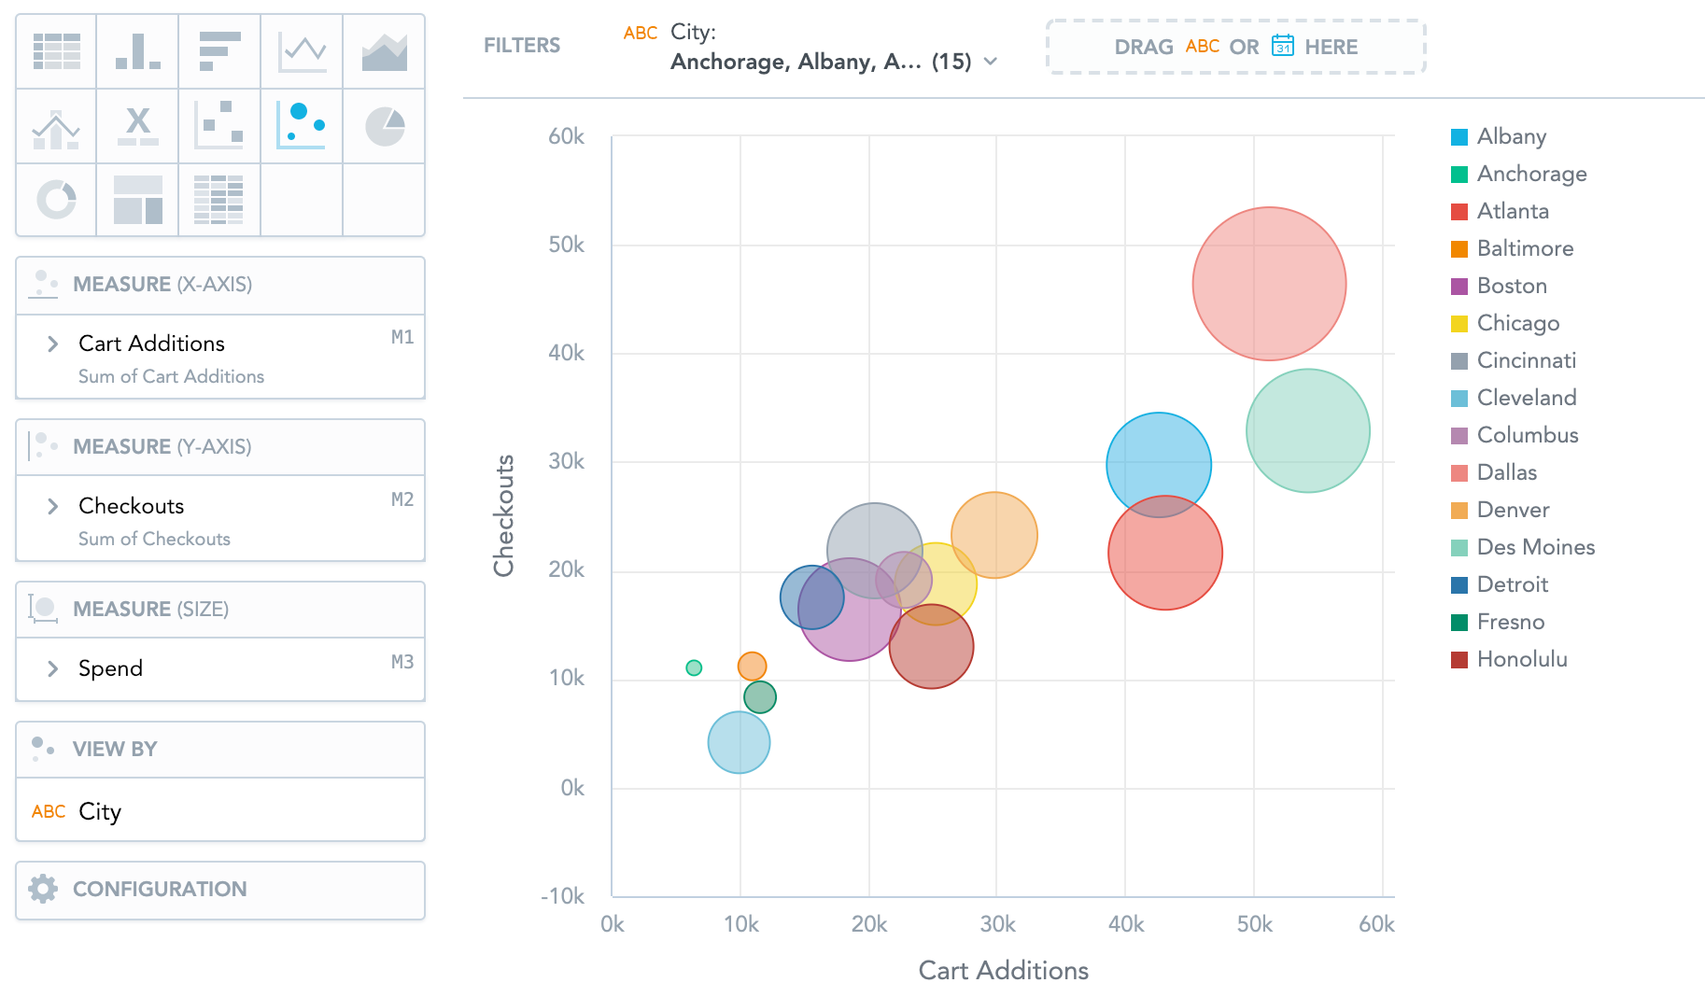
Bubble Chart
Data is plotted on a coordinate plane
Points on chart vary in size based on magnitude

Slide 9
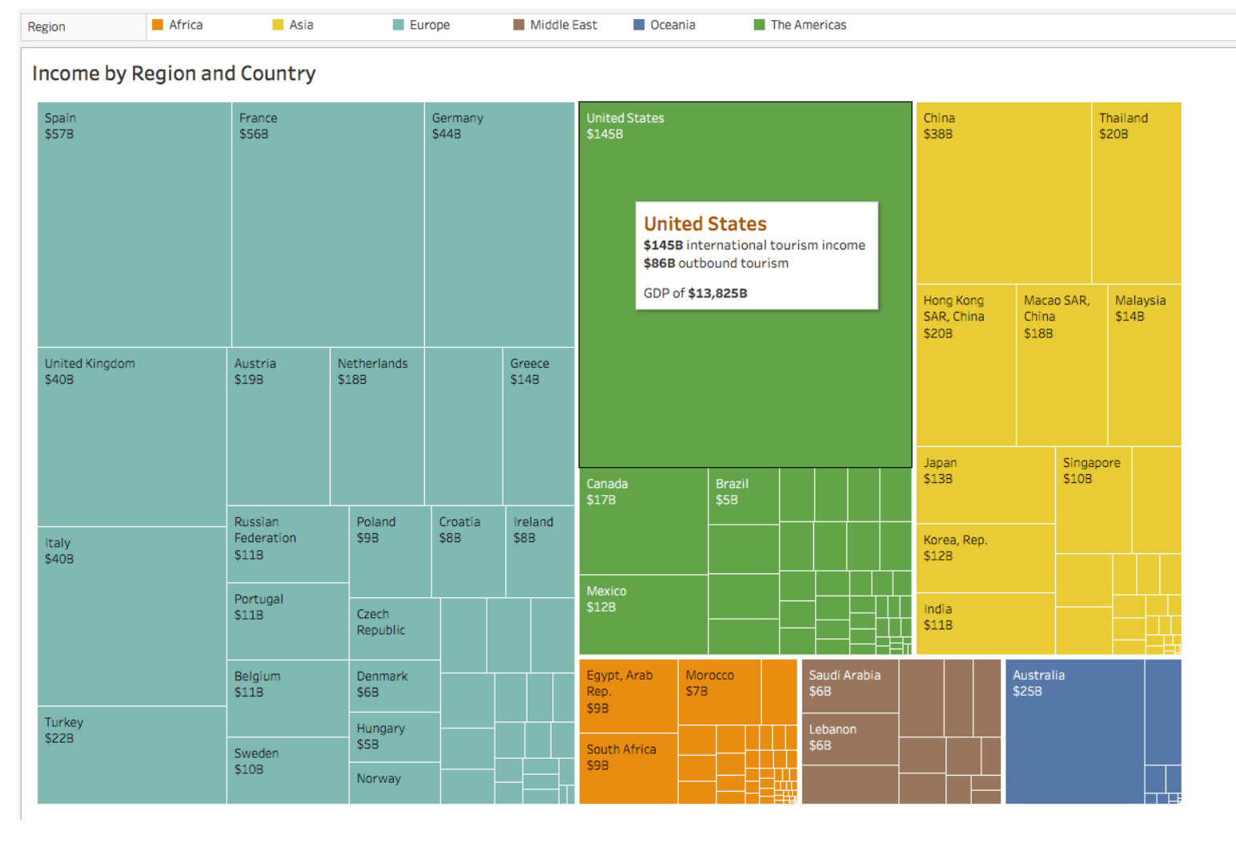
Tree Map
Area of squares shows relative magnitude of each category

Slide 10
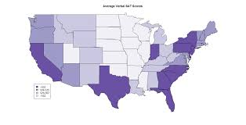
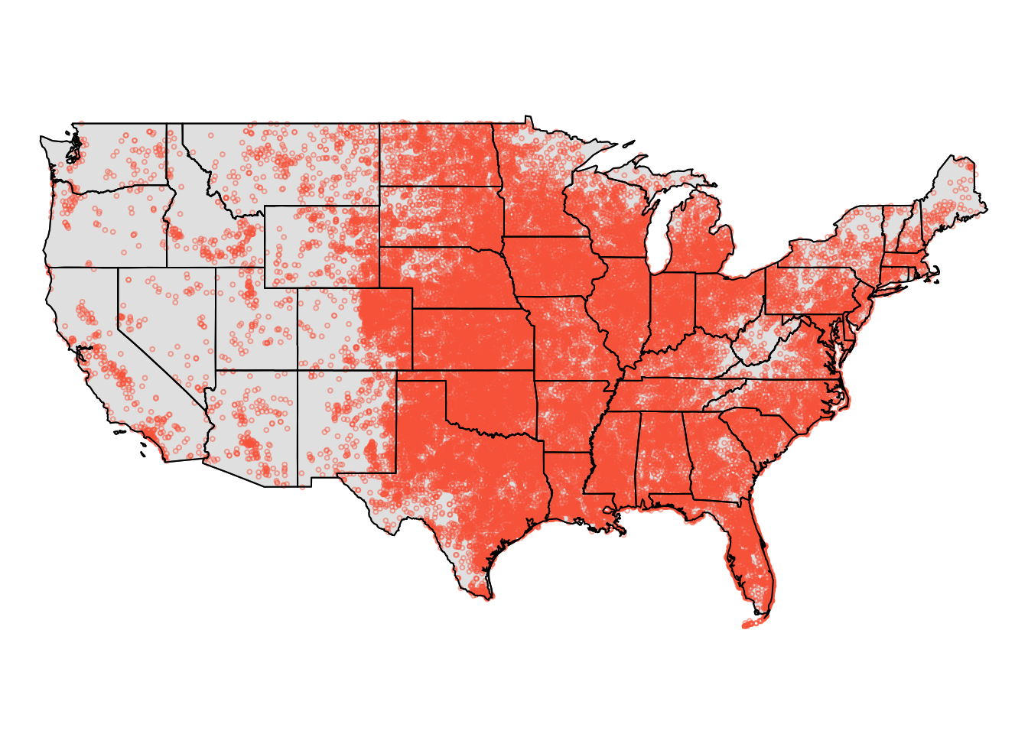
Spatial Data
Spatial data: Data with a location component
Data added to map as labels, points, colors, etc.

Slide 11
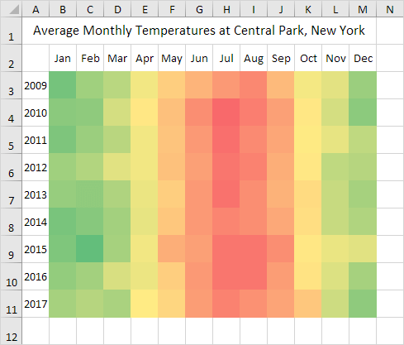
Heat Maps
Color of segment indicates direction and/or magnitude
Can be configured all sorts of ways

Slide 12
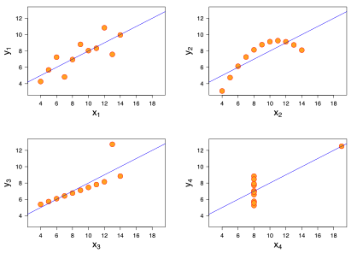
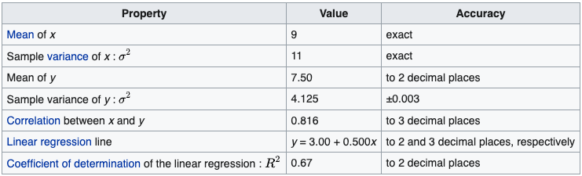
Descriptive Statistics Pitfall Alert
Which graph is are the summary statistics describing?

Slide 13
ALL OF THEM!

Slide 14
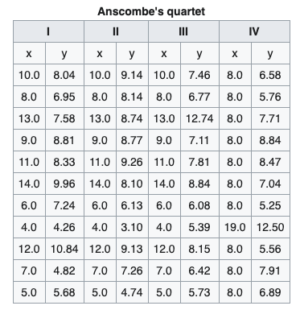
Anscombe's Quartet

Slide 15
Key lesson of Anscombe's Quartet: Visualizing data is a critical part of analysis, not just for fun, aesthetics, and/or showing others!!!

Slide 16
Graphics In R
Base R
Scatter plot of x and y = plot(x,y)
To add a trendline, use abline(lm(y~x)) after the plot is created
Histogram of x = hist(x)
Kernel density of x = plot(density(x))
Pie chart = pie(slices,values)
Use ggplot2 library if you want to make better / more complex graphics

